Slide 1

Fake Photos
Did you know:
Project Real was created by young people, teachers, university academics and influencers

Slide 2
Aims
Understand why people might edit photos
Know some things to look for to spot Fake Photos
The impact that seeing Fake Photos might have on people
Notes:
Please go through the aims of the project

Slide 3
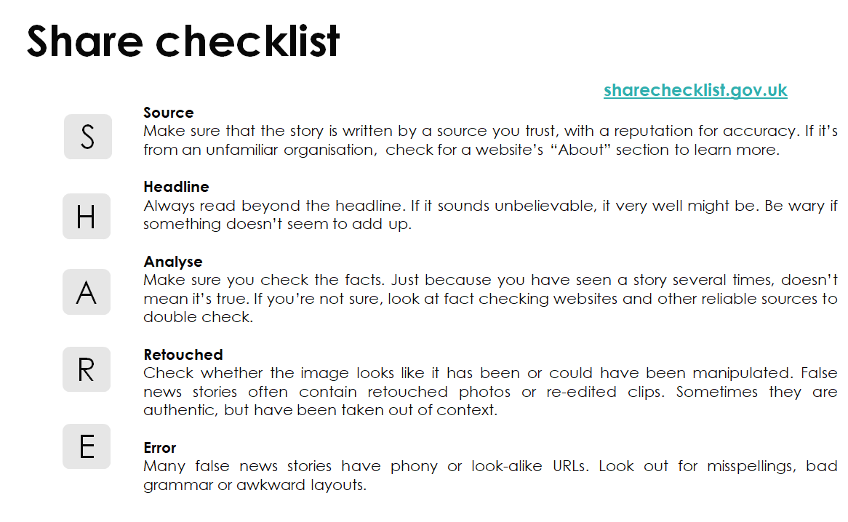
Notes:
Please reiterate the ‘SHARE’ guidelines to remind students of them

Slide 4
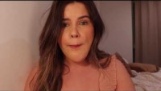
Introduction- Katie’s view on photo editing
Notes:
Katie is a disability activist and discusses problems with photoshopping I
https://www.youtube.com/watch?v=6i_O9jdz7pkmages

Slide 5
Starter - Activity
Spot the difference
Look at the photos: Where do you think they have been photoshopped?
Also, why do you think they made that edit?

Slide 6
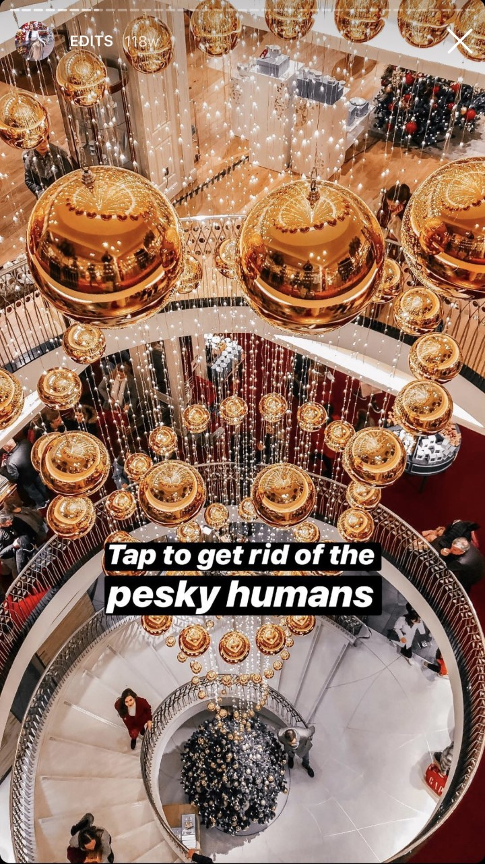
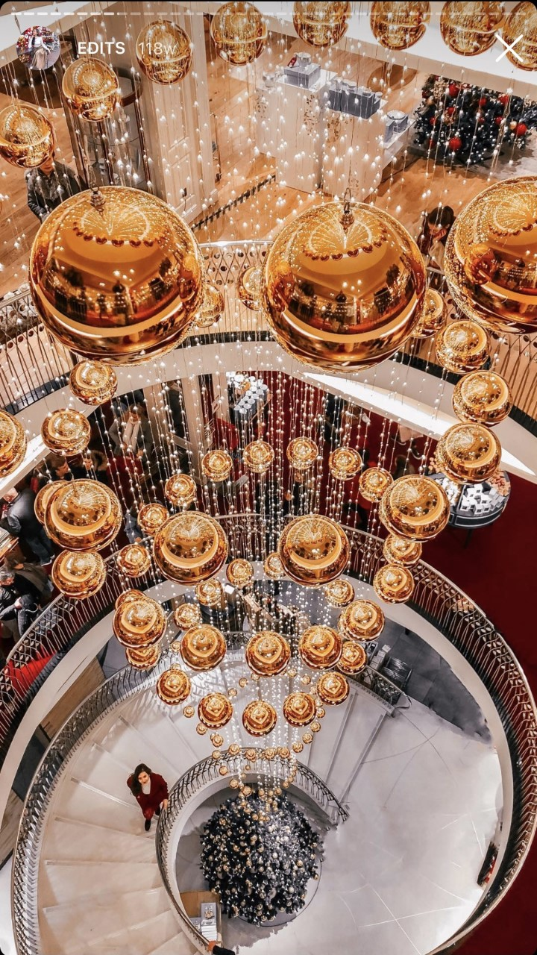
Here is an example
Notes:
The answer is given on the image here, they have photoshopped out the other people in the mall
Potentially to balance, the image and keep the focus on themselves. But also perhaps to make them seem like they are alone in the mall.

Slide 7
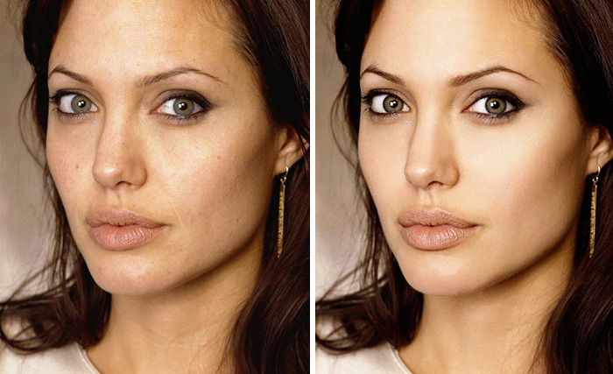
Notes:
Angelina Jolie
Edited her skin (removed freckles and pores) changed the light balance, made her eyebrows neater. Whites of the eyes have been recoloured.
To make her look prettier/ younger?

Slide 8

Questions
Where do you think the photo has been photoshopped?
Why do you think they made that edit?

Slide 9
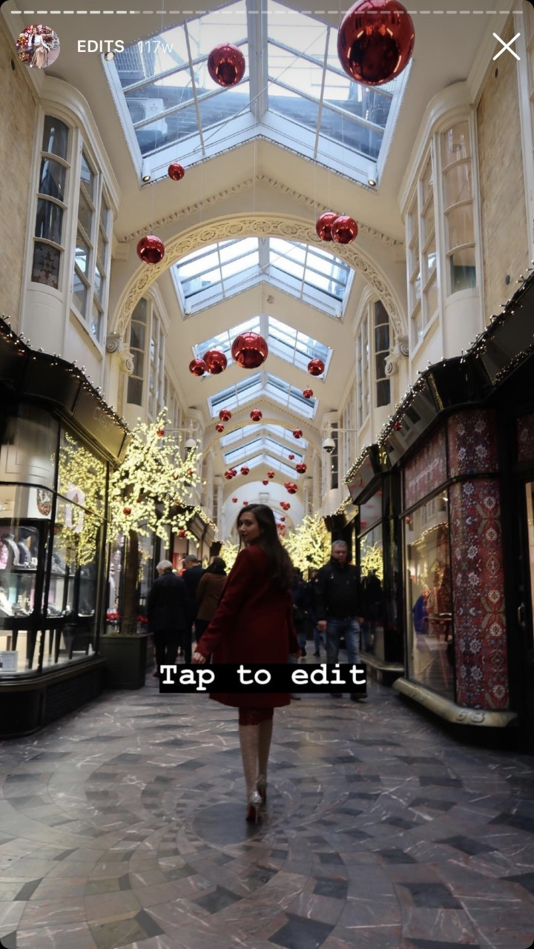
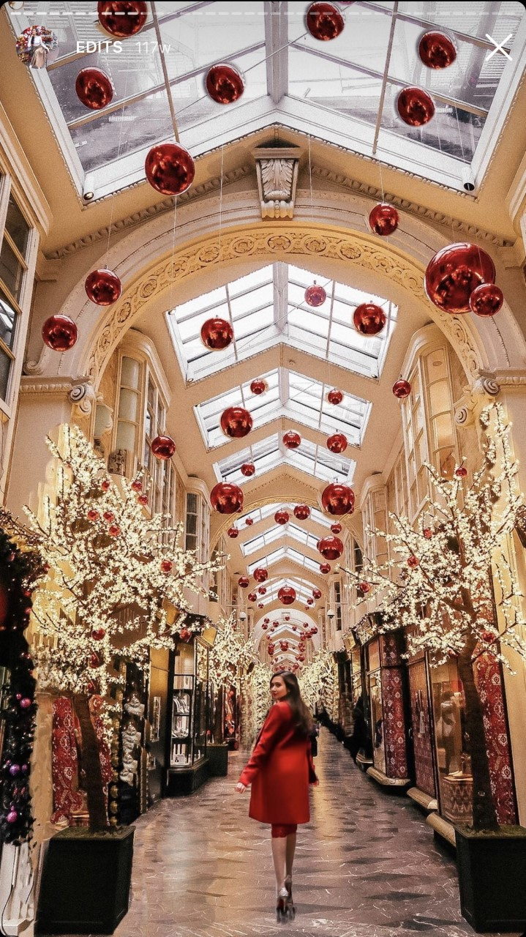
Notes:
Light balance has been changed
People have been removed
Balloons have been added, as have trees. The angle has been changed
Makes the picture look nicer and brighter (but other people might think that the mall is usually empty or looks like this in real life). Also you cannot see a shadow which can be a clue for photoshopping.

Slide 10
Questions
Where do you think the photo has been photoshopped?
Why do you think they made that edit?

Slide 11
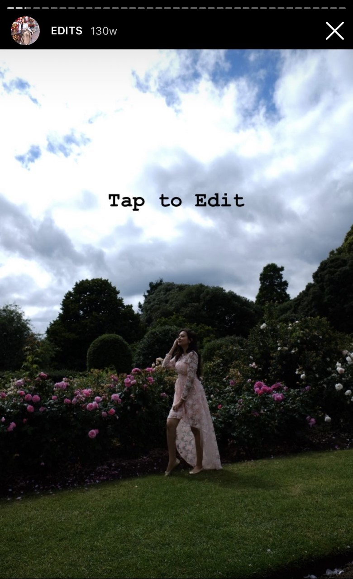

Notes:
Light balance
Plane added in
Added shaping on the leg
Makes it seem brighter and more summery. Might encourage people to think she is travelling somewhere

Slide 12
Questions
Where do you think the photo has been photoshopped?
Why do you think they made that edit?

Slide 13
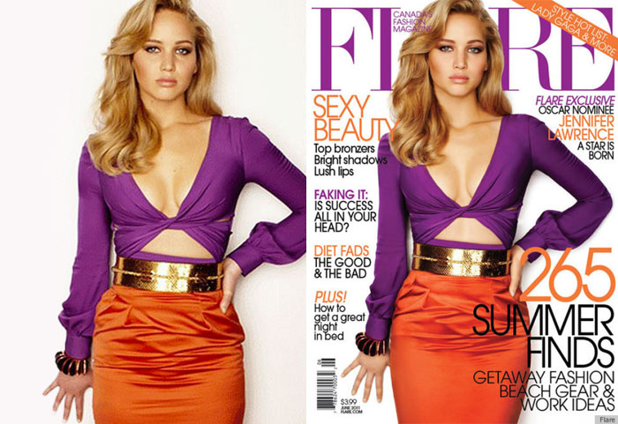
Notes:
This is a picture of Jennifer Laurence
Pulled in waist, edited the lines on her skirt, edited her hand to make it skinnier, added a line on her stomach, balanced her skin
Presumably to make her look prettier?

Slide 14
Questions
Where do you think the photo has been photoshopped?
Why do you think they made that edit?

Slide 15

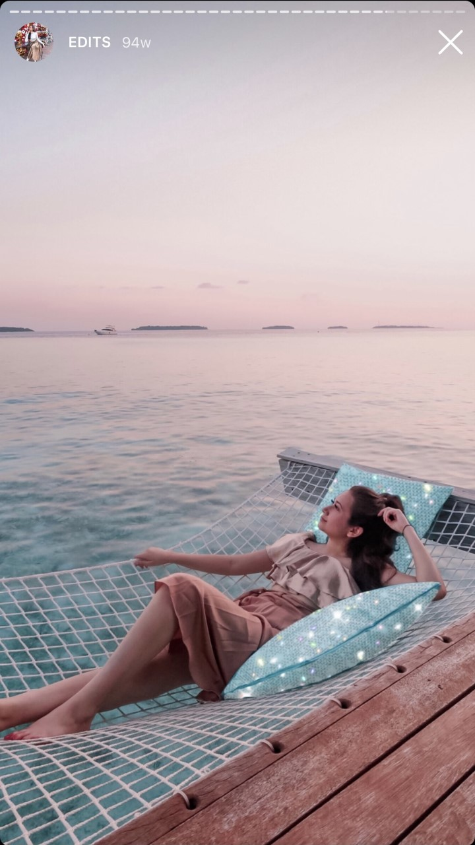
Notes:
Light balance
Sparkles on the cushions
Makes it seem more ‘magical’ and in focus

Slide 16
Questions
Where do you think the photo has been photoshopped?
Why do you think they made that edit?

Slide 17
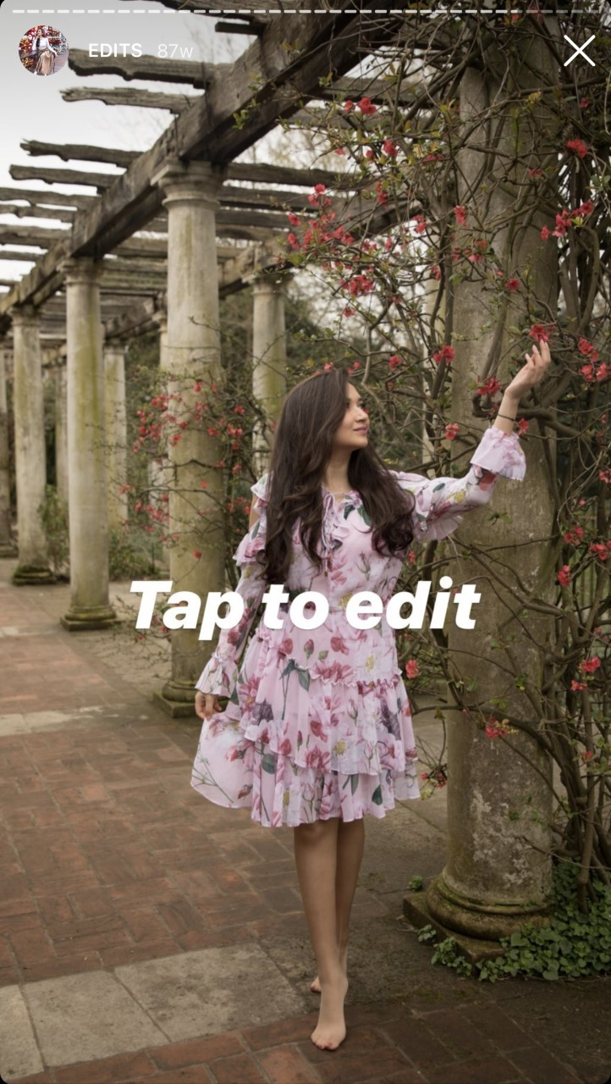
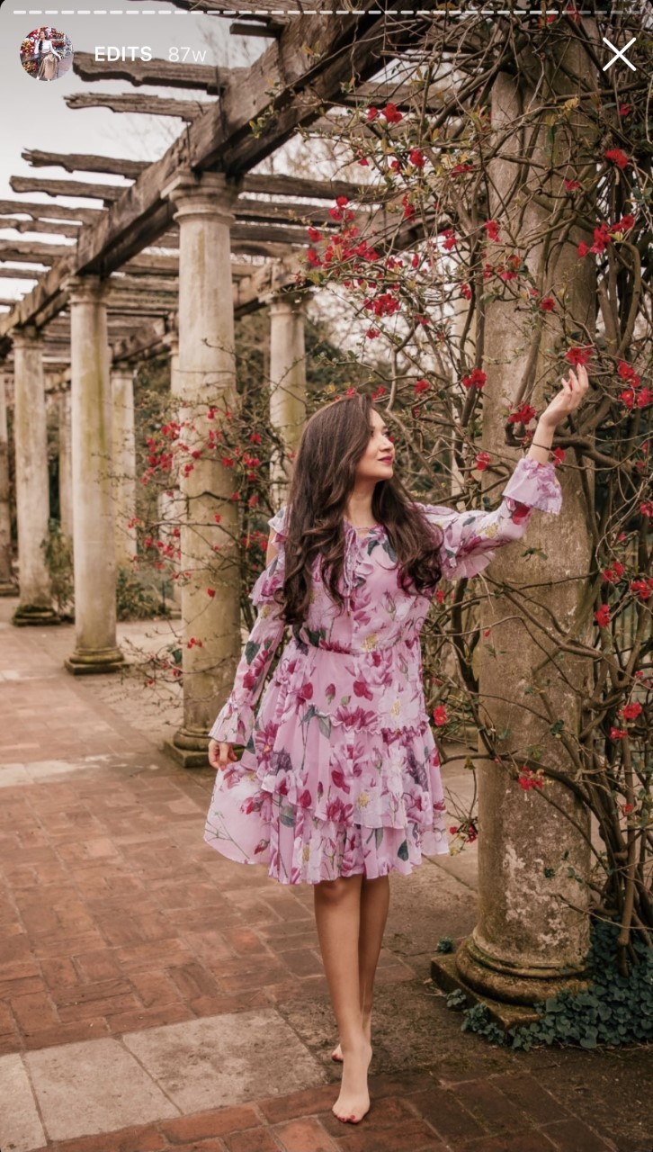
Notes:
Light balance
Looks nicer. Might make the dress look nicer if she got it for free to advertise it

Slide 18
Questions
Where do you think the photo has been photoshopped?
Why do you think they made that edit?

Slide 19
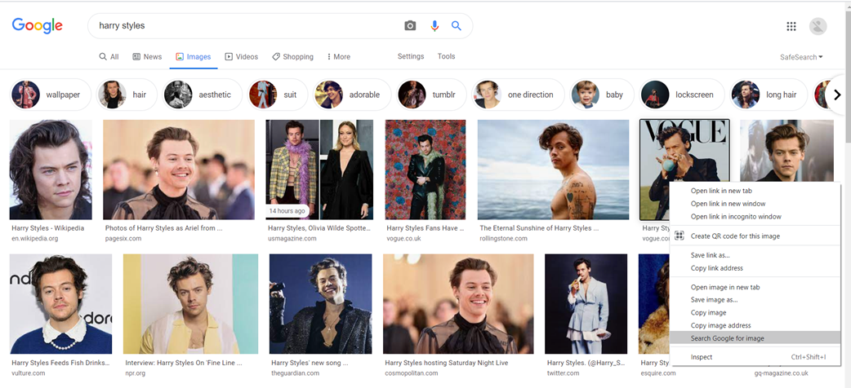
Reverse image search
Notes:
This is how to do a reverse image search, right click the image and then scroll down to ‘search google for image

Slide 20
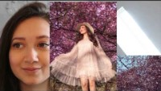
Bushra discusses photo editing
Notes:
In this video, Bushra discusses how she uses editing software. She also encourages students to look at images and see how they think she has edited them. We put a pause in the video, but it is short. You can leave the video playing or pause it to have a longer discussion.
https://www.youtube.com/watch?v=xpPOeAlXmdU

Slide 21
Main Activity
Create a poster to help others to recognise fake photos and understand why they should care about this topic.
Whatever you choose to produce, however, needs to cover the following:
-What are Fake Photos?
-How to detect Fake Photos?
-Why do people edit their photos?
-How might seeing edited photos impact people?
Notes:
TEACHERS: You can decide if you want them to hand draw, do a poster on powerpoint, Canva etc

Slide 22
Closing Activity
In your groups, note down answers to following quiz questions.
Notes:
Ask students to get into groups and nominate someone to answer. The first person to put their hand up and get the right answer wins a point for their team.

Slide 23
What are 3 things someone might edit in or out of a picture?

Slide 24
What things could you do to check if a photo is real or not?
Name at least 3 things.

Slide 25
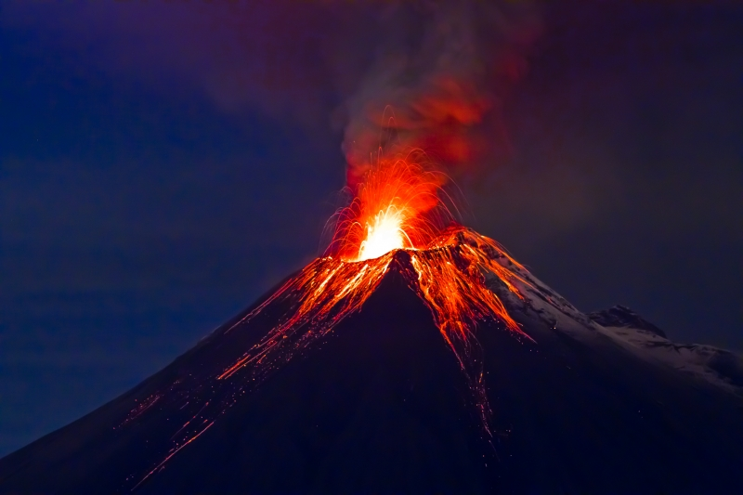

Which photo is fake?

Slide 26
Give two examples of the positive impact fake photos can have?

Slide 27


Which photo is fake?

Slide 28
Give two examples of the negative impact fake photos can have?

Slide 29
Closing Activity
How did you do?

Slide 30
What are 3 things someone might edit in or out of a picture?
Spots/Blemishes/Scars/
People
Shape of a body
Weather
Parts of landscapes (buildings, trees etc)
Others?

Slide 31
What things could you do to check if a photo is real or not? Name at least 3 things.
See if the background is blurred (Retouch)
Zoom in to see if the pixels look right
Check for any mistakes e.g. no shadow, looks strange (Errors)
Do a reverse image search
See who posted it (Source)
Others?
Notes:
TEACHERS: link back to SHARE guidelines, not just the image but Source/Headline/Accuracy/Retouching/Errors

Slide 32
Which photo is fake?
Notes:
A is fake, B is real
(from fake or foto)
https://area.autodesk.com/fakeorfoto/

Slide 33
Give two examples of the positive impact fake photos can have?
Makes the photos look better
Get rid of blur
Keeps the focus on the subject of the photo
If you e.g., get rid of a spot, you might feel, better about sharing the photo
If it is a group shot, you can make sure everyone is looking at the camera
Others?

Slide 34
Which photo is fake?
Notes:
A is real, B is fake
(from fake or foto)
https://area.autodesk.com/fakeorfoto/

Slide 35
Give two examples of the negative impact fake photos can have?
Can make people feel bad about their own bodies
Can make people feel disappointed when they go to a place and it does not look like it does in pictures
Can be used to deceive people in online shopping
Can be used to make fake news stories seem more real
Can make people feel bad about their lifestyle
Others?

Slide 36

What’s your score?
1-3: Try again ☺
4-6: Keep working
7-9: Social Media Influencer
10-12: Fake Photo Guru!

Slide 37
Summary
Today you have learned:
What things to look out for to spot fake photos
Why people might edit photos
The impact that seeing fake photos might have on people

Slide 38
Links to our learning
Modern Studies: You might want to think about Fake Photos in Modern Studies considering how photos might be used by different organisations to influence people’s views and emotions
Art: Editing photos is an important part of artistic expression, but considering when editing may be harmful is also important

Slide 39

Next week…
FAKE PEOPLE
A session looking a fake news in social media more broadly

